Slide 1

Understanding FlutterPackages and Plugins
Integrating Third-Party Plugins & Case Studies: Popular Flutter Plugins

Slide 2
Introduction
Flutter packages are collections of reusable code written in Dart that help you add specific functionality to your Flutter app without writing everything from scratch.(using pub.dev)
Examples:
http → For making network requests
google_fonts → For using Google Fonts easily
Plugins are special types of packages that include platform-specific code (written in Java/Kotlin for Android and Objective-C/Swift for iOS).
They allow Flutter apps to use native device features.
Examples:
camera → Access device camera
geolocator → Access location services

Slide 3
TYPES OF PACKAGES AND PLUGIN
1. Official Packages
Developed and maintained by the Flutter (Google) team.
Fully tested, secure, and compatible with the latest Flutter SDK.
flutter_localizations(Support multiple languages),
google_fonts (Use Google Fonts easily)
2. Community Packages
Created and maintained by Flutter developers or open-source communities.
Freely available on pub.dev.
carousel_slider(Create image sliders)

Slide 4
TYPES OF PACKAGES AND PLUGIN
3. Third-Party (External) Packages
Developed by individual developers or organizations outside the Flutter community.
May be hosted on GitHub, private repositories, or custom servers.

Slide 5
FINDING AND INSTALLING PACKAGES AND PLUGINS
find Flutter packages and plugins on the official website:
👉 https://pub.dev
Steps:
Go to pub.dev
In the search bar, type the package name (e.g., “http”, “camera”, “provider”)
Click on the package to view:
Copy and paste in pubspec.yaml

Slide 6
Integrating Third-Party Plugins
Lottie is a third-party plugin used to display high-quality vector animations in Flutter apps.
These animations are usually created in Adobe After Effects and exported as JSON files using the Bodymovin plugin.
Step 1: Add Dependency
Step 2: Import the Package
Step 3: Add a Lottie Animation
Add your animation file (e.g., loading.json) to your assets folder.
Register it in pubspec.yaml:
Step 4: Use in a Widget

Slide 7
EXERCISES

Slide 8
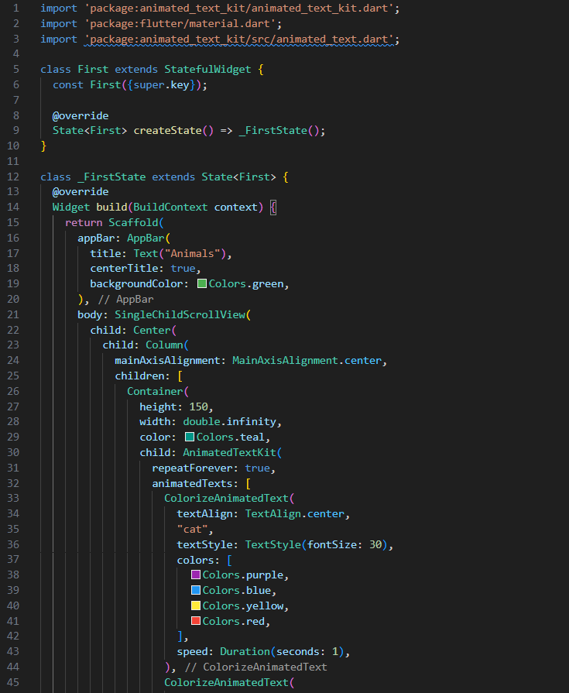
EXERCISE 1

Slide 9
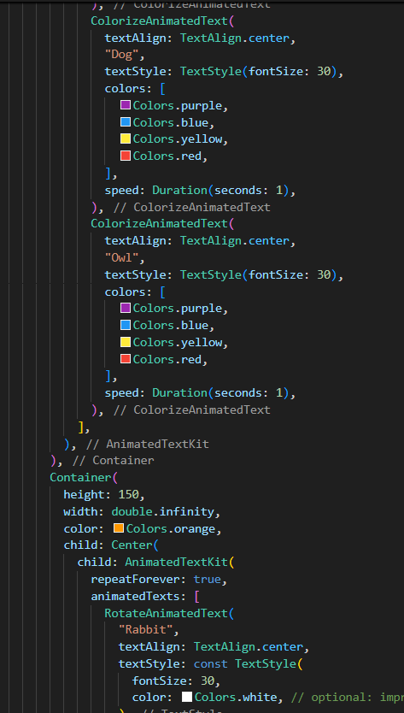
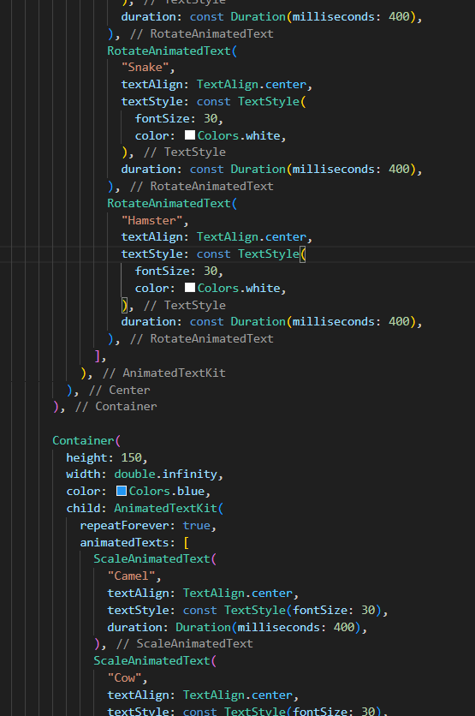

Slide 10
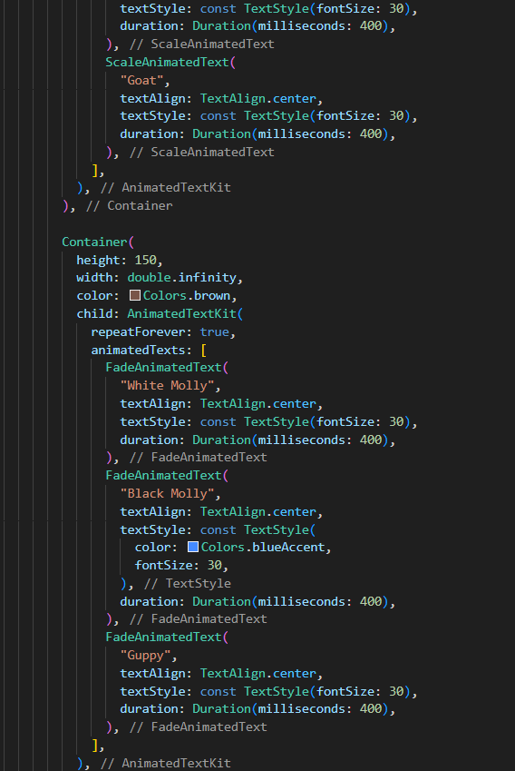
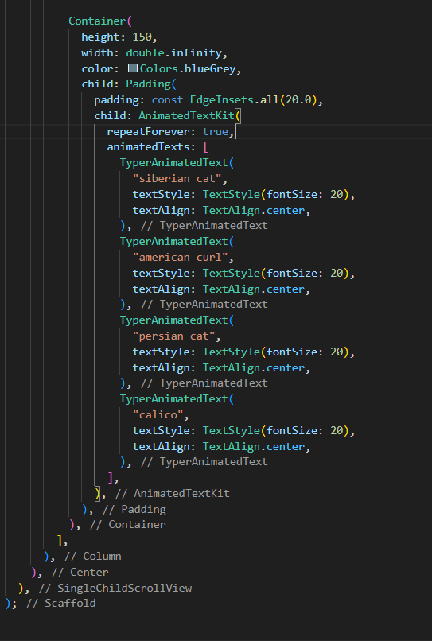

Slide 11
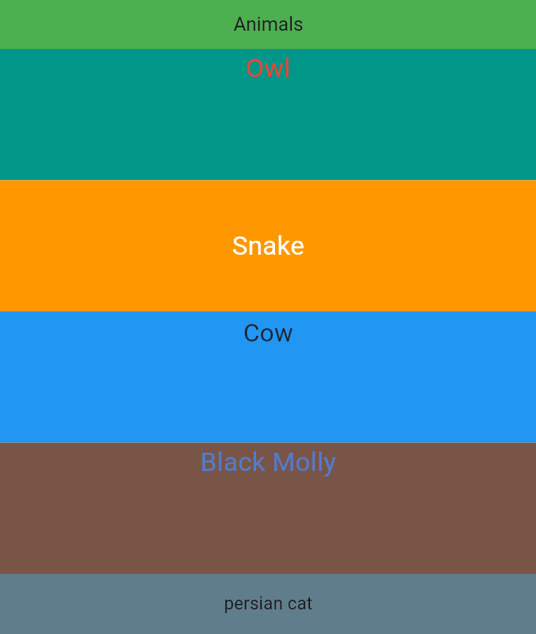

Slide 12
EXERCISE 2

Slide 13
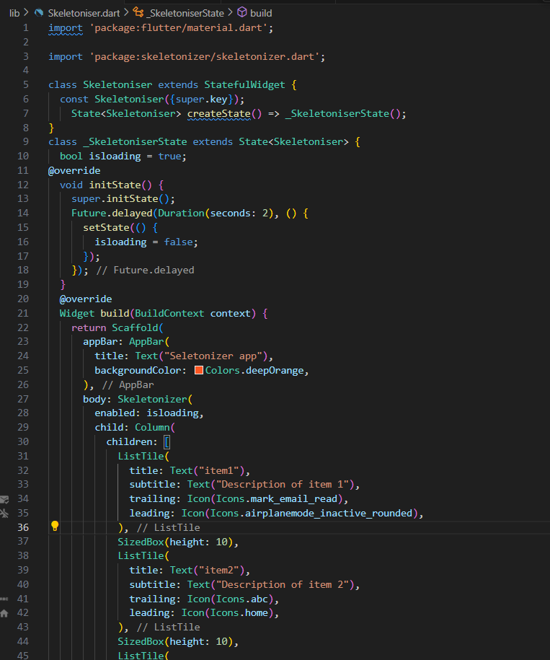
Activity 1

Slide 14
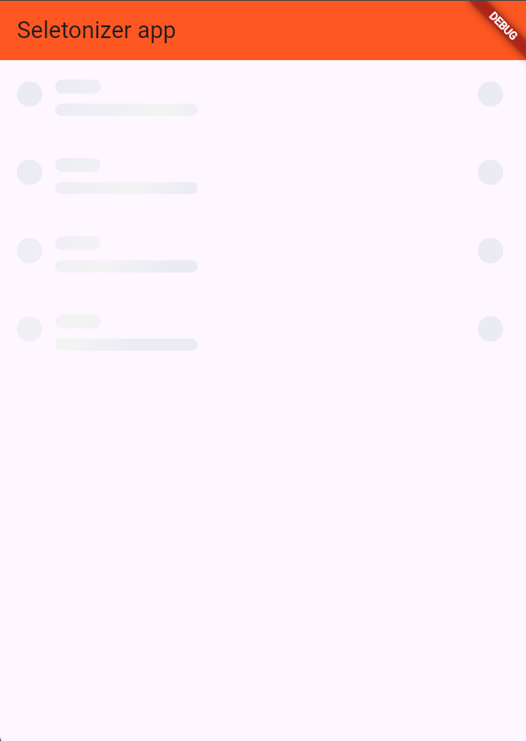
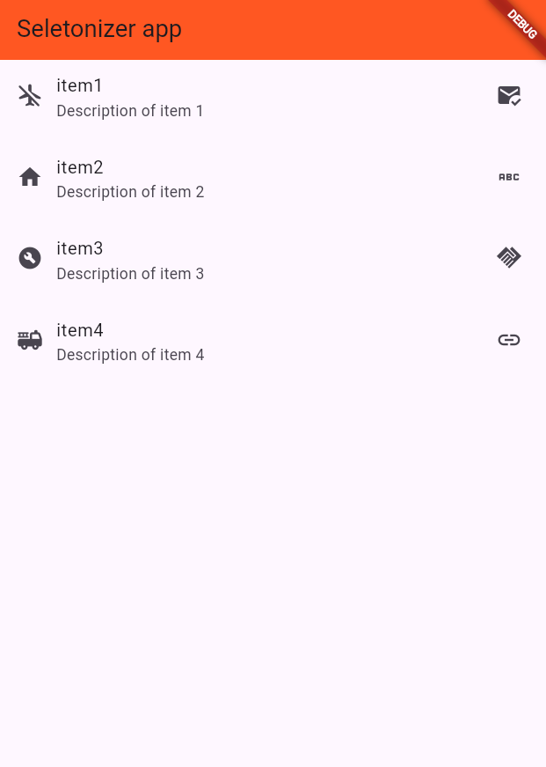

Slide 15
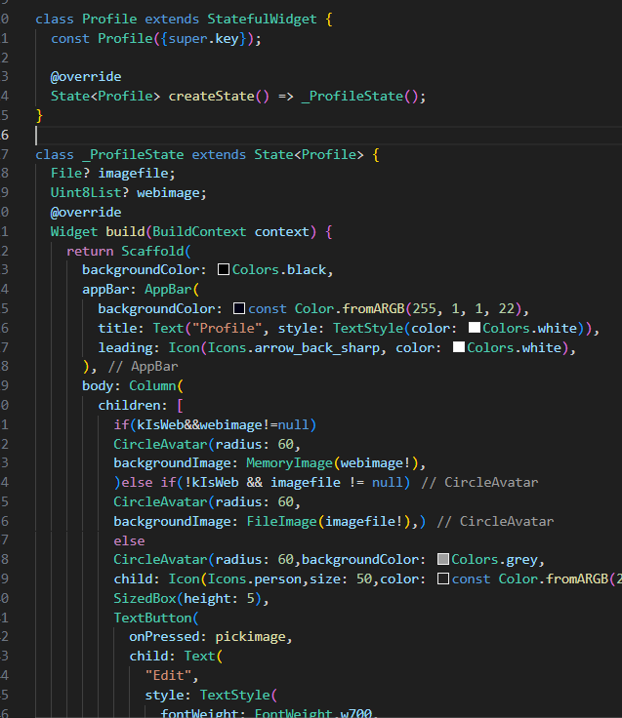
activity 2

Slide 16
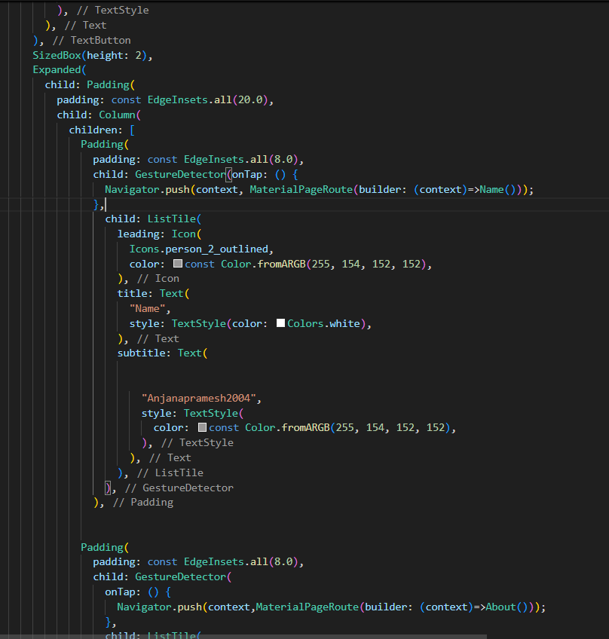
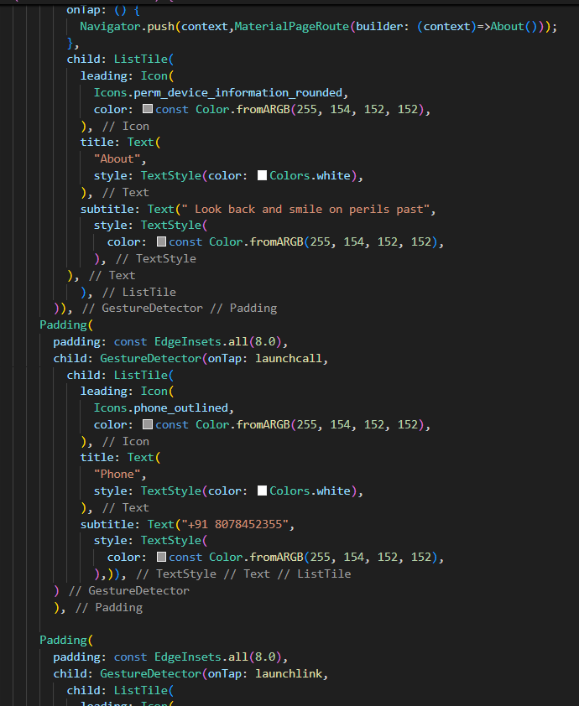

Slide 17
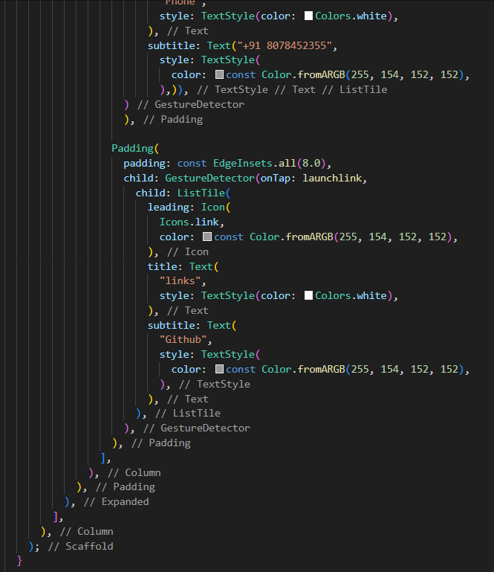
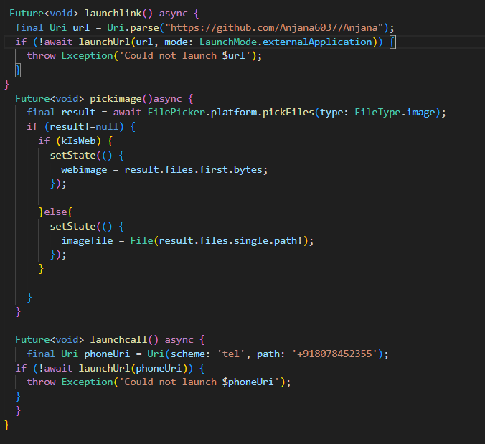

Slide 18
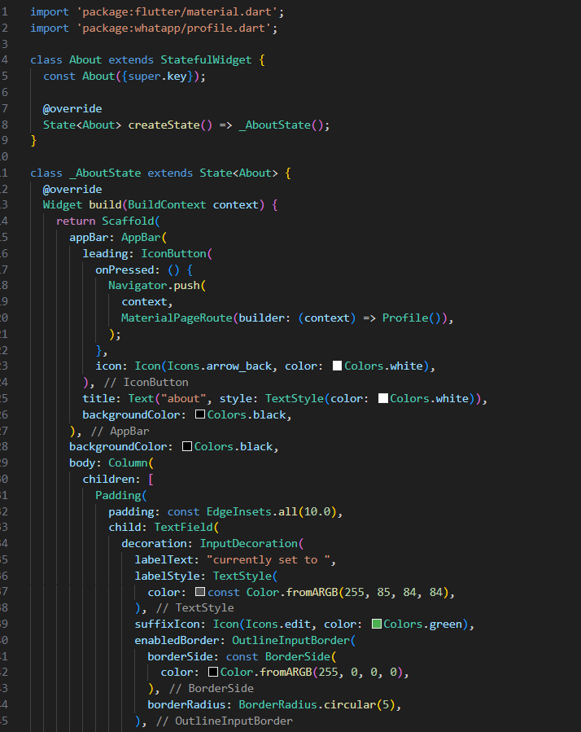
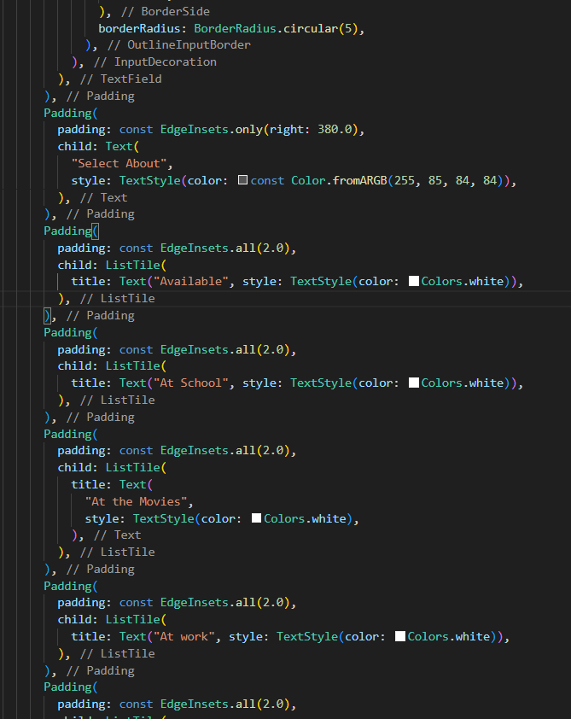

Slide 19
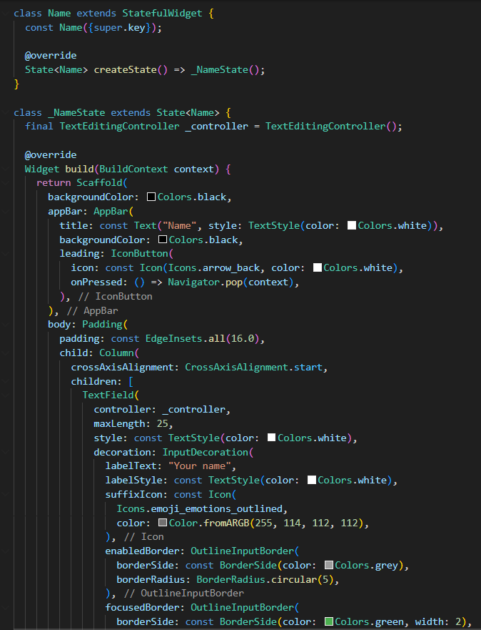
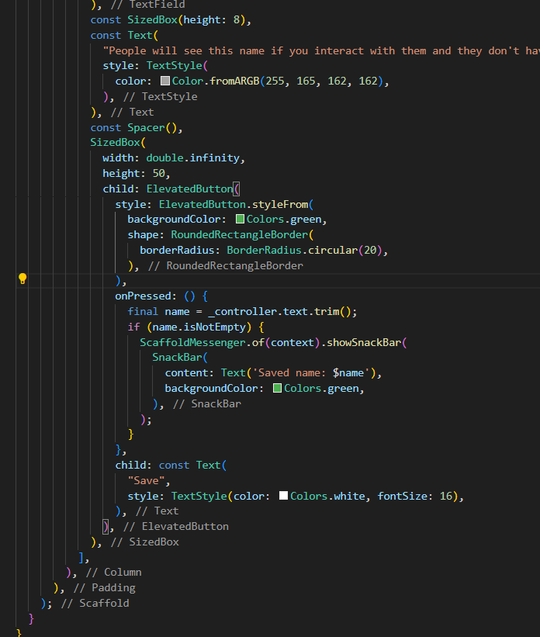

Slide 20
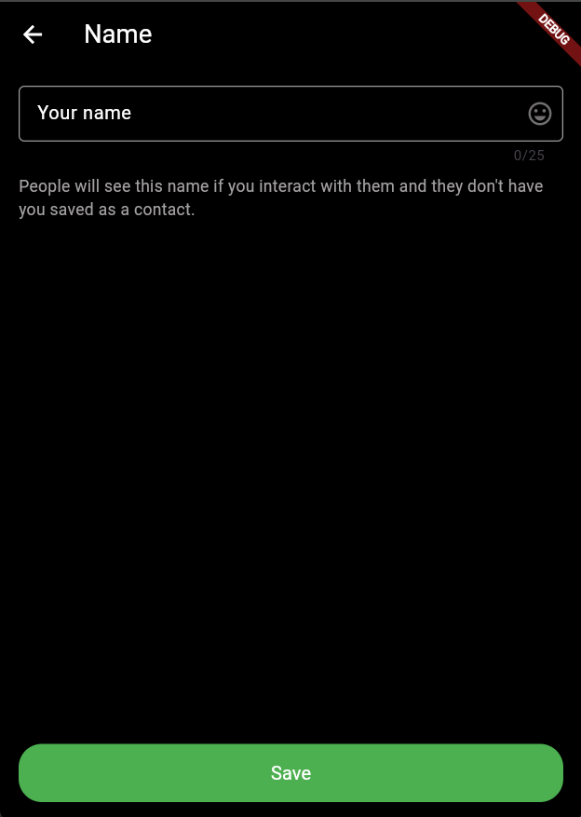
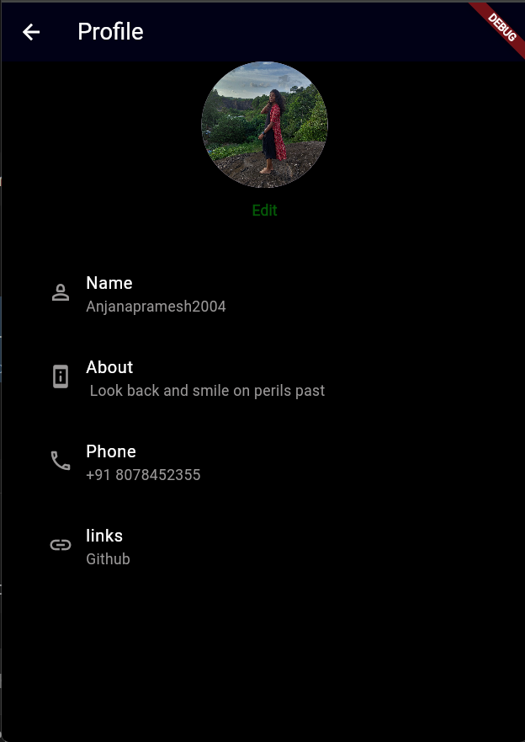
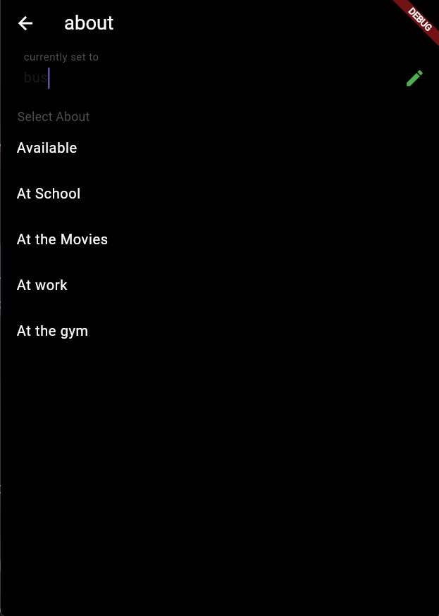
activity 2

Slide 24
activity 2

Slide 25
EXERCISE 1

